Slide 1



Project: Magician
Status Update

Slide 2

Work Status Update for the Project Magician
Key Points:
Assembling of the Tool
Integrating FT sensor and Real Sense module
First Manual Experimentation with the Tool
Current On-going work.

Slide 3
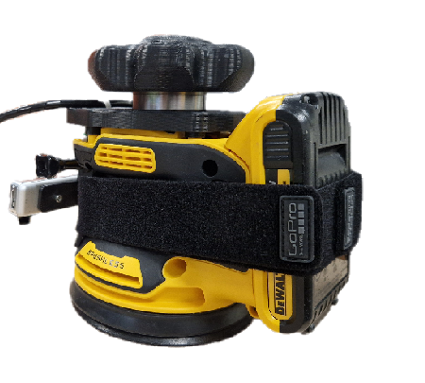
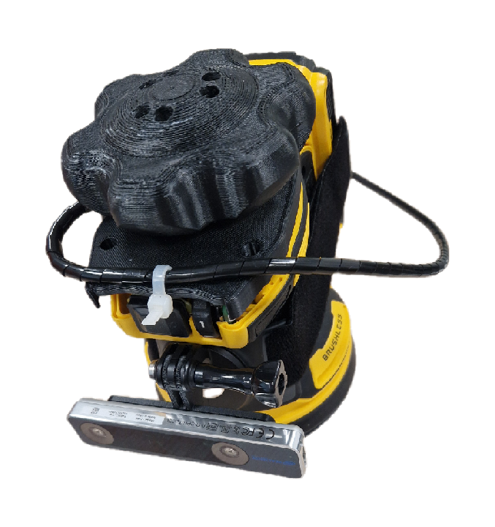
Work Status Update for the Project Magician
Assembling of the Tool:
Did the assembly of the tool with all the essential sensor components mounted rigidly and ready for the initial trails.

Slide 4
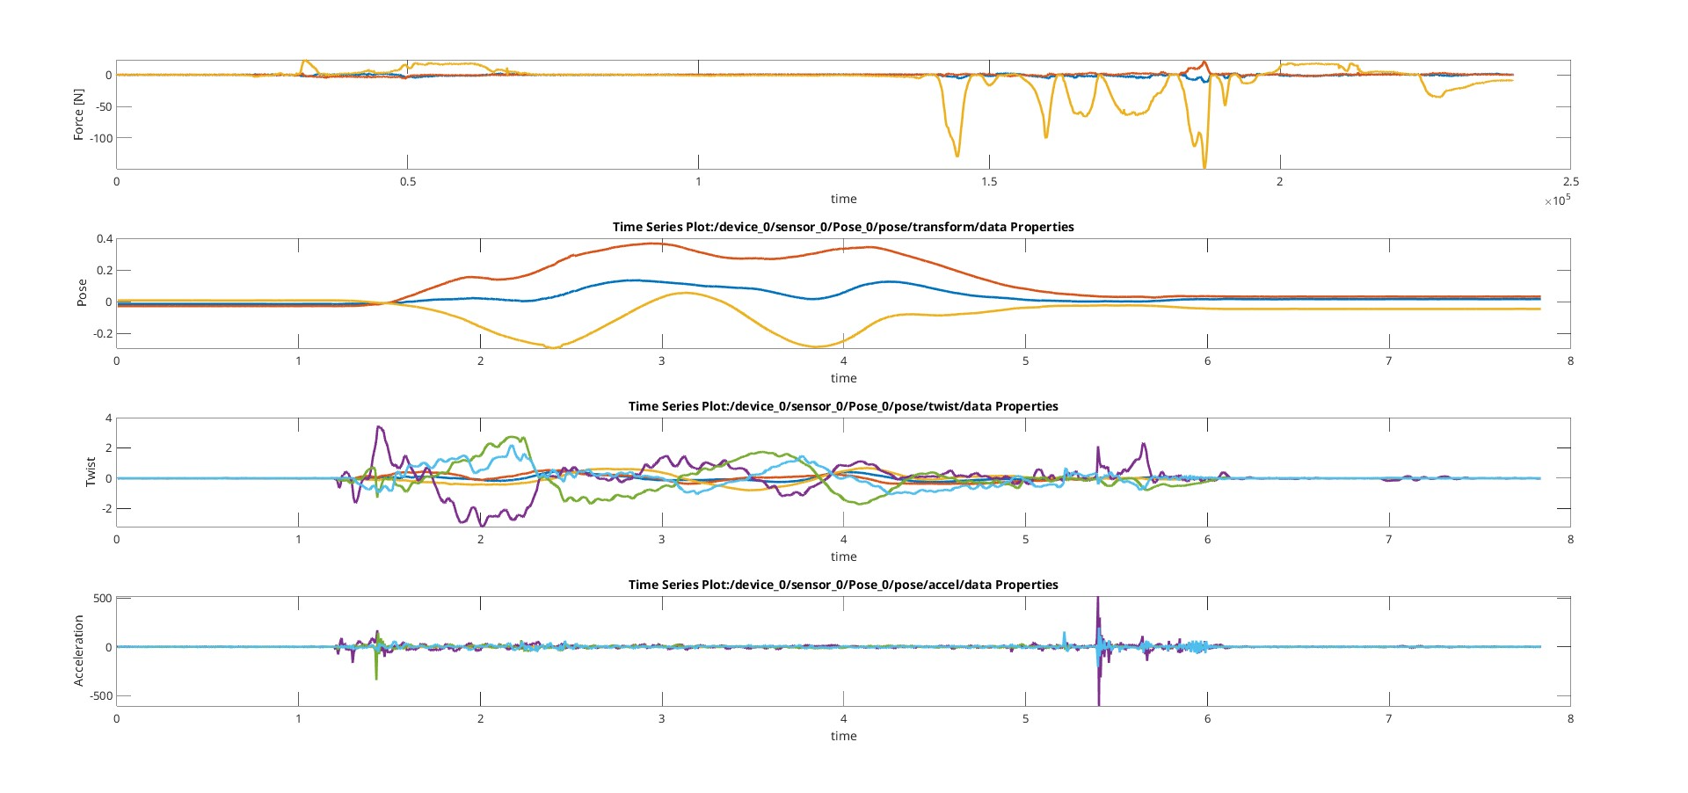
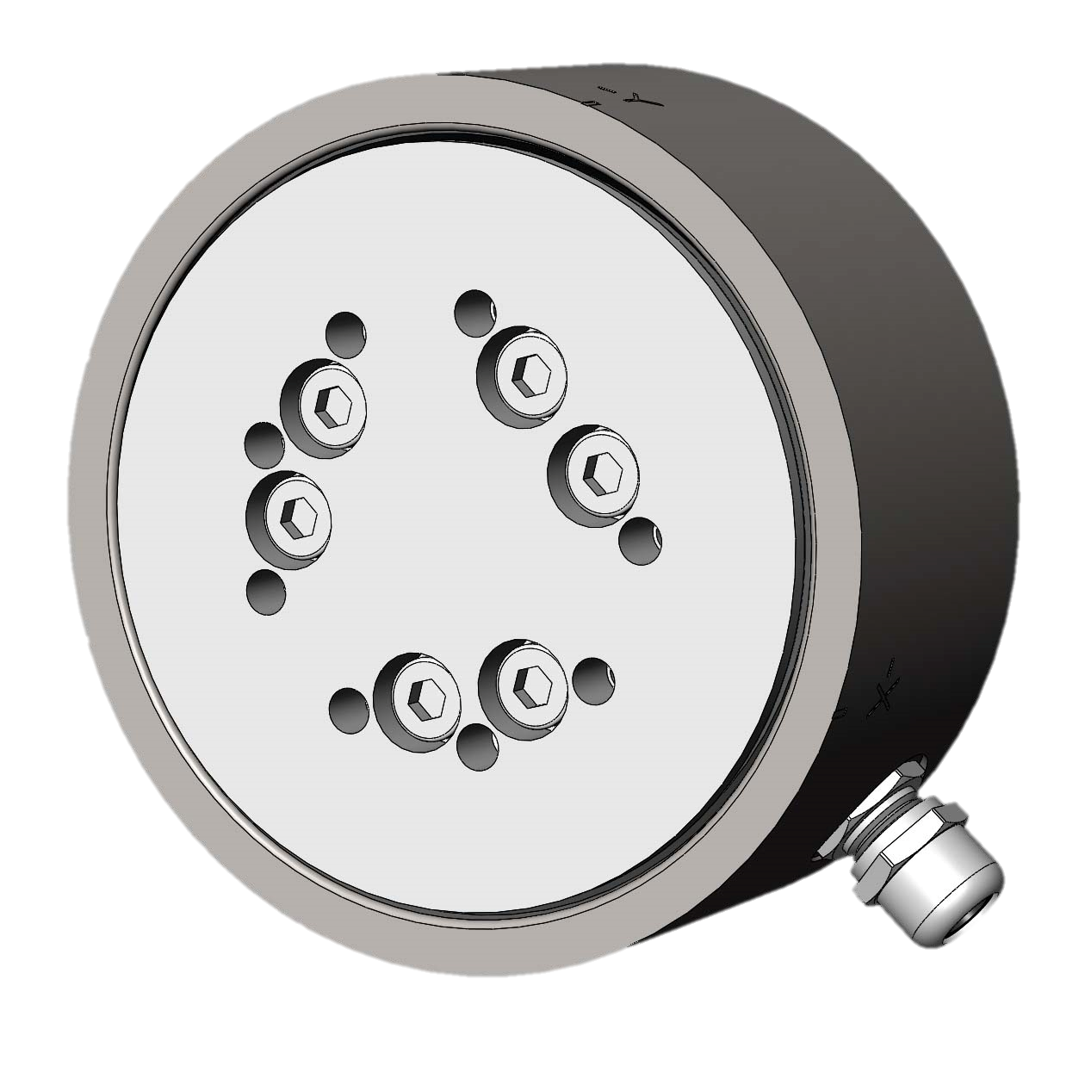
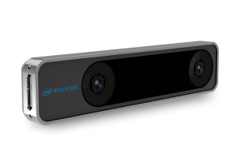
Work Status Update for the Project Magician
Integrating FT sensor and Real Sense module:
Got some initial readings from the FT sensor as well as the Real Sense module ( Code : Davide).

Slide 5
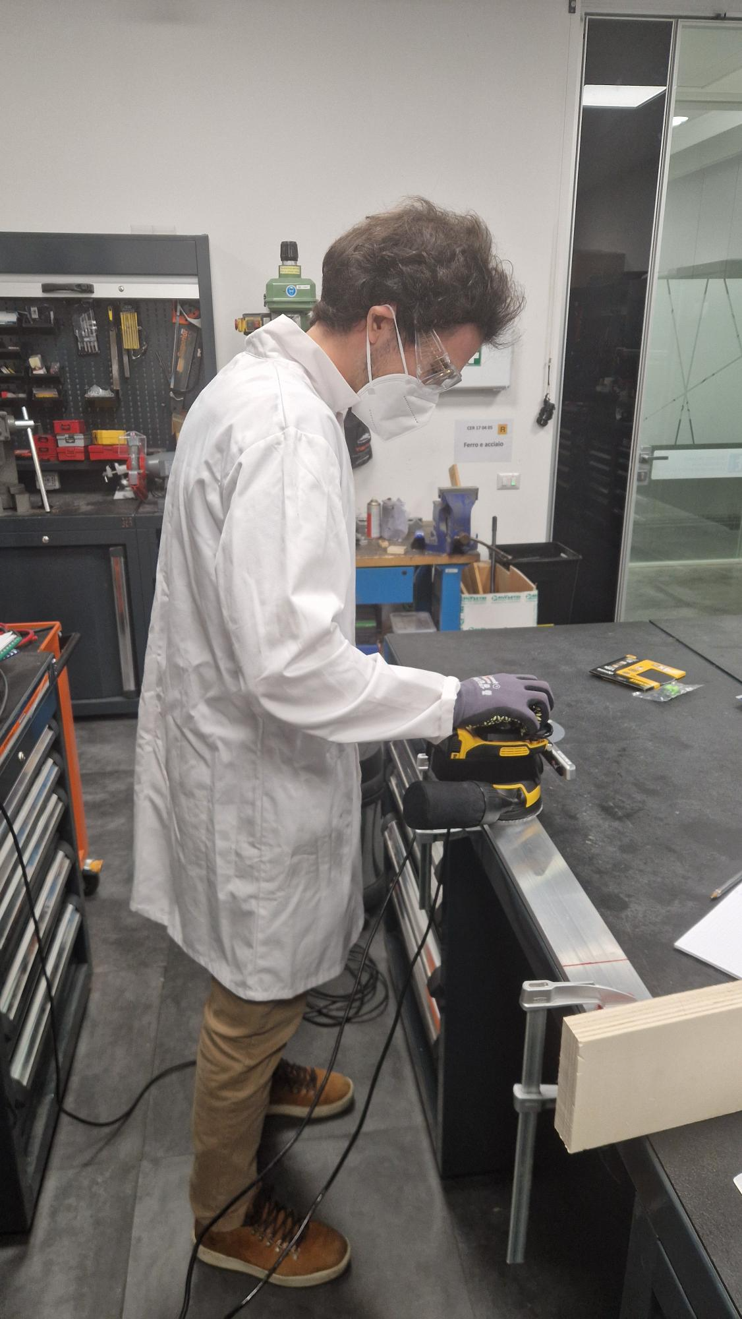
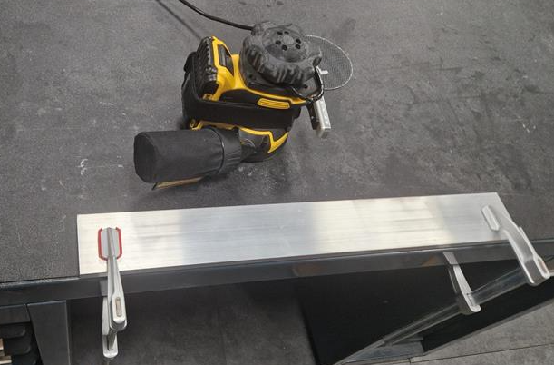
Work Status Update for the Project Magician
First Manual Experimentation with the Tool :
Collected the data from both the sensors mainly FT sensor to analyse the forces that were generated while performing sanding/polishing operations.
Performed both the Static and dynamic motion test with different seed settings and varying pressure applied on the tool while preforming the operation. ( time for each trial : 15sec).

Slide 6
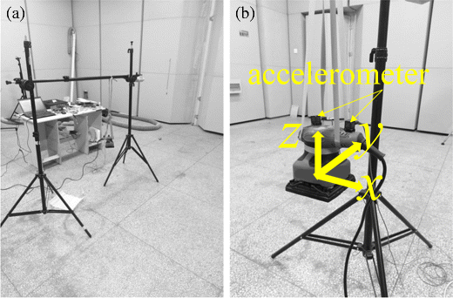
Work Status Update for the Project Magician
FT sensor
Current On-going work:
Now I will be going to analyse the frequencies from the reading that were obtained through these tests and find whether there could be any Vibrations that could affect the robot during its final task. ( if possible, calculate the stiffness and damping from the forces obtained)
Also, I like to do a test for the tool from a free hanging state without any external disturbances and factor to effect so that I we could be able to obtain its natural frequency for variable speeds. ( as specified in Shi et al.)
Cited : Shi et al
Shi, L., Sun, B. Modeling and optimization of vibration response characteristics of the orbital sander based on surrogate model. Struct Multidisc Optim 57, 2259–2271 (2018). https://doi.org/10.1007/s00158-017-1856-4
L. Shi and B. Sun, “Mathematical modeling and vibration simulation of an orbital sander,” Vibroengineering PROCEDIA, Vol. 22, pp. 176–181, Mar. 2019, https://doi.org/10.21595/vp.2018.20466

Slide 7

Work Status Update for the Project Magician
Thank you very much for your Attention

